Slide 1


SUBJECT:
Advanced Java Programming
TOPIC:
Hibernate
Jatin Ambasana
This work is licensed under a Creative Commons Attribution-NonCommercial-ShareAlike 4.0 International License. You are free to use, distribute and modify it, for noncommercial purposes only, provided you acknowledge the source.

Slide 2
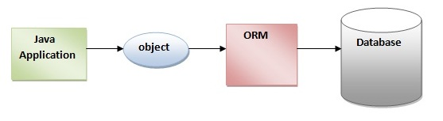
Introduction to Hibernate
Hibernate framework simplifies the development of java application to interact with the database.
Hibernate is an open source, lightweight, ORM tool - Object-Relational Mapping (ORM)
ORM tool simplifies the data creation, data manipulation and data access.
ORM tool internally uses the JDBC API to interact with the database.
A programming technique that maps the object to the data in database.

Slide 3
Introduction to Hibernate (cont.)
An open source persistent framework created by Gavin King in 2001.
Powerful, high performance Object-Relational Persistence and Query service for any Java Application.
Maps Java classes to database tables and from Java data types to SQL data types
Relieves developer from 95% of common data persistence related programming tasks.

Slide 4
ORM Tool
ORM tool
Simplifies data creation, manipulation & its access.
A programming technique that maps the object to the data stored in the database.
Database
Java
Application
Java Object
ORM
What is JPA?
Java Persistence API (JPA) is a Java specification that provides certain functionality and standard to ORM tools.
javax.persistence package contains the JPA classes and interfaces.

Slide 5
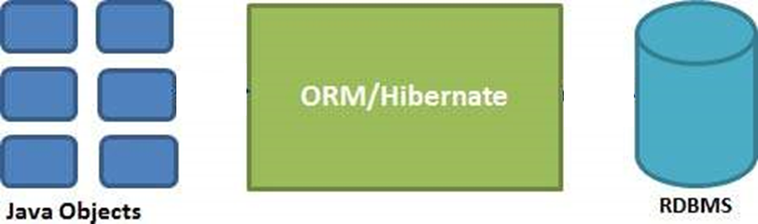
Introduction (cont.)
Sits between traditional Java objects & database server
Handles all the work for persisting Java objects based on the appropriate O/R mechanisms and patterns.

Slide 6
Hibernate Advantages
Mapping Java classes to database tables
Using XML files & without writing any line of Java code.
Provides simple APIs for
Storing and Retrieving Java objects directly to and from the database.
If there is change in the database or in any table, then you need to change the XML file properties only.

Slide 7
Hibernate Advantages (cont.)
Abstracts away the unfamiliar SQL types and provides a way to work around familiar Java Objects.
Hibernate does not require an application server to operate.
Manipulates Complex associations of objects of your database.
Minimizes database access with smart fetching strategies.
Provides simple querying of data.

Slide 8
Hibernate Advantages (cont.)
Open Source and Lightweight
Hibernate framework is open source under the GPL license and lightweight.
Fast Performance
The performance of hibernate framework is fast because of the cache that is internally used in hibernate framework.
Two types of cache in hibernate framework
First level cache & Second level cache.
First level cache is enabled by default.

Slide 9
Hibernate Advantages (cont.)
Database Independent Query
HQL (Hibernate Query Language) is the object-oriented version of SQL.
Generates the database independent queries.
NO need to write database specific queries.
Before Hibernate, If database is changed for the project, then we need to change the SQL query as well that leads to the maintenance problem.

Slide 10
Hibernate Advantages (cont.)
Automatic Table Creation
Facility to create tables of the database automatically.
No need to create tables in the database manually.
Simplifies Complex Joins
Fetching data from multiple tables is easy.
Provides Query Statistics and Database Status
Supports Query cache and provide statistics about query and database status.

Slide 11
Hibernate Advantages (cont.)
Oracle DB
SQL 1
Java
Application
Java Object
JDBC Driver
PostgreSQL
DB
SQL 2

Slide 12
Supported Databases
Hibernate supports almost all the major RDBMS.
Following is a list of few of the database engines supported by Hibernate −
HSQL Database Engine
DB2/NT
MySQL
PostgreSQL
FrontBase
Oracle
Microsoft SQL Server Database
Sybase SQL Server
Informix Dynamic Server

Slide 13
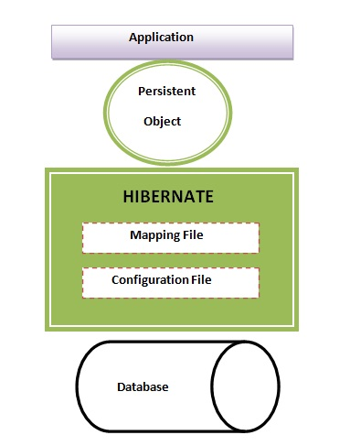
Hibernate Architecture
4 layers in hibernate architecture:
Java Application layer,
Hibernate framework layer,
Backhand API layer and
Database layer.

Slide 14
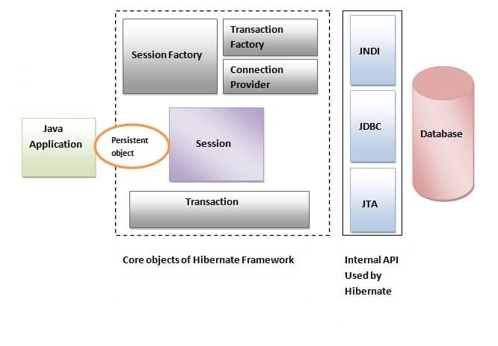
Hibernate Architecture
Includes many objects such as
persistent object
session factory
transaction factory
connection factory
session, transaction etc.

Slide 15
Hibernate Architecture (cont.)

Slide 16
Elements of Hibernate Architecture
SessionFactory : Provides factory method to get the object of Session.
Session : Provides an interface between the application and data stored in the database.
A short-lived object
It wraps the JDBC connection
The org.hibernate.Session interface provides methods to insert, update and delete the object.
It also provides factory methods for Transaction and Query.

Slide 17
Elements of Hibernate Architecture (cont.)
Transaction : org.hibernate.Transaction interface provides methods for transaction management.
ConnectionProvider : It is a factory of JDBC connections.
TransactionFactory : It is a factory of Transaction. It is optional.

Slide 18
Configuration Object
First Hibernate object that you create in any Hibernate application.
Usually created only once during application initialization.
It provides two keys components:
Database Connection:
Handled through one or more configuration files supported by Hibernate.
hibernate.properties and hibernate.cfg.xml.
Class Mapping Setup:
It creates the connection between the Java classes & database tables.

Slide 19
SessionFactory Object
Configuration object is used to create a SessionFactory object which in turn configures Hibernate for the application using the supplied configuration file and allows for a Session object to be instantiated.
The SessionFactory is a thread safe object and used by all the threads of an application.
The SessionFactory is a heavyweight object;
Usually created during application start up and kept for later use.
One SessionFactory object is needed per database using a separate configuration file.
Multiple databases ➔ then create multiple SessionFactory objects

Slide 20
Session Object
Used to get a physical connection with a database.
Lightweight
Instantiated each time an interaction is needed with the database.
Persistent objects are saved and retrieved through Session.
Should not be kept open for a long time
Not usually thread safe
Should be created and destroyed as needed.

Slide 21
Transaction Object
Represents a unit of work with the database
Most of the RDBMS support transaction functionality
Handled by an underlying Transaction manager and transaction objects (from JDBC or JTA).
An optional object
Hibernate applications may choose not to use this interface
Instead choose managing transactions in their own application code

Slide 22
Query Object
Query objects use
SQL / Hibernate Query Language (HQL) strings
To retrieve data from the database and create objects.
A Query instance is used…
To bind query parameters
To limit the number of results returned
To execute the query
Criteria Object
To create and execute
Object oriented criteria queries to retrieve objects.

Slide 23
Hibernate Configuration
Hibernate requires to know in advance
Where to find the mapping information
Defines how your Java classes relate to DB tables.
Requires a set of configuration settings related to database and other related parameters.
All such information is usually supplied
as a standard Java properties file hibernate.properties,
or as an XML file hibernate.cfg.xml.

Slide 24
Hibernate Properties
hibernate.dialect
Makes Hibernate generate the appropriate SQL for the chosen database.
hibernate.connection.driver_class
The JDBC driver class.
hibernate.connection.url
The JDBC URL to the database instance.
hibernate.connection.username
The database username.

Slide 25
Hibernate Properties
hibernate.connection.password
The database password.
hibernate.connection.pool_size
Limits the number of connections waiting in the Hibernate database connection pool.
hibernate.connection.autocommit
Allows autocommit mode to be used for the JDBC connection.

Slide 26
Hibernate O/R MAPPING
The mapping document is an XML document having <hibernate-mapping> as the root element which contains <class> elements corresponding class.
The <class> elements are used to define specific mappings from a Java classes to the database tables. The Java class name is specified using the name attribute of the class element and the database table name is specified using the table attribute.
The <id> element maps the unique ID attribute in class to the primary key of the database table. The name attribute of the id element refers to the property in the class.
The <generator> element within the id element is used to generate the primary key values automatically. The class attribute of the generator element is set to native to let hibernate pick up either identity, sequence to create primary key depending upon the capabilities of the underlying database.
The <property> element is used to map a Java class property to a column in the database table. The name attribute of the element refers to the property in the class and the column attribute refers to the column in the database table. The type attribute holds the hibernate mapping type, this mapping types will convert from Java to SQL data type.

Slide 27
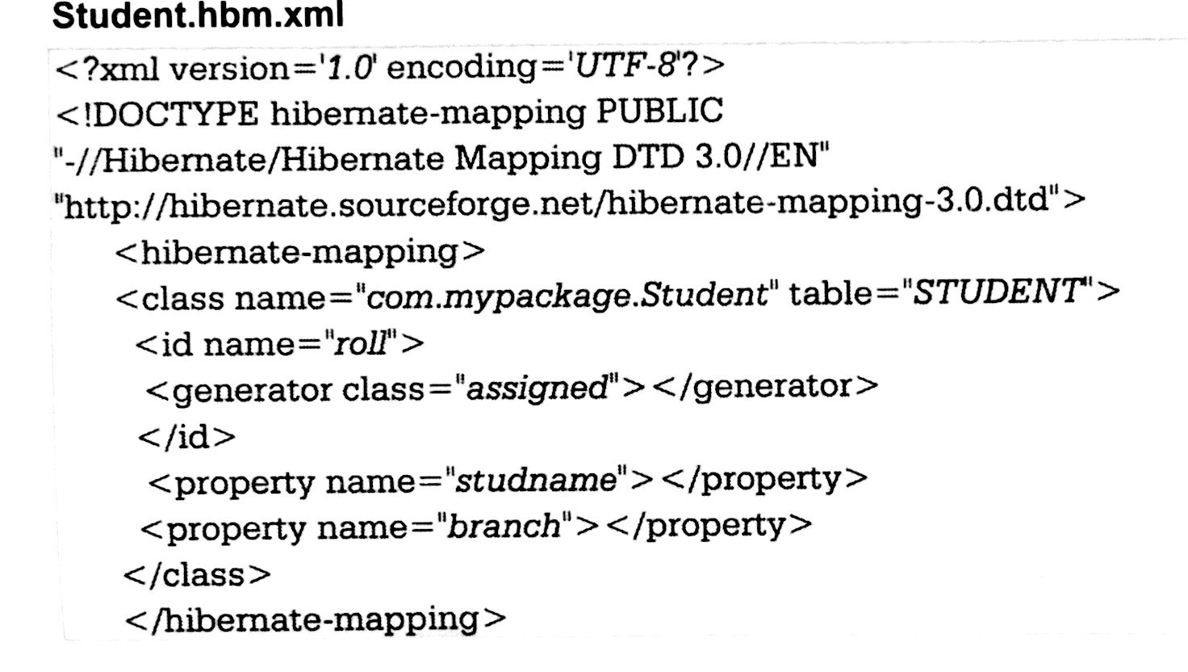
Hibernate O/R MAPPING
O/R Mapping is usually defined in XML document.
The mapping language is java-centric, meaning that mapping is constructed around persistence class declaration.

Slide 28
Hibernate O/R MAPPING (cont.)
An XML document having
<hibernate-mapping> root element
Contains <class> elements

Slide 29
Hibernate O/R MAPPING (cont.)
<class> elements
To define specific mappings from a Java classes to the database tables.
Class name ➔ name attribute of the class element
Database table name ➔ the table attribute

Slide 30
Hibernate O/R MAPPING (cont.)
<id> element
Maps the unique ID attribute in class to the primary key of the database table.
name attribute of the id element ➔property in the class

Slide 31
Hibernate O/R MAPPING (cont.)
The <generator> element within the id element
Used to generate the primary key values automatically
class attribute of the generator element is set to
assigned, increment, hilo, sequence, native, etc.

Slide 32
Hibernate O/R MAPPING (cont.)
<property> element
To map a Java class property to a column in the database table.
name attribute ➔ property in the class
column attribute ➔ column in the database table
type attribute holds the hibernate mapping type
This mapping type will be converted from Java to SQL data type.

Slide 33
Hibernate Annotation
A powerful way to provide the metadata for the Object and Relational Table mapping.
All the metadata is clubbed into the POJO Class file along with the code
Helpful to understand the table structure & POJO during the development.
If you going to make your application portable to other EJB 3 compliant ORM applications, you must use annotations to represent the mapping information, but still if you want greater flexibility, then you should go with XML-based mappings.

Slide 34
Hibernate Annotation (cont.)
@Entity Annotation
On Employee class
Marks this class as an entity bean
It must have a no-argument constructor
with at least protected scope.
@Table Annotation
To specify the details of the table ➔ used to persist the entity in the database.
Provides four attributes:
Allowing you to override the name of the table
Its catalogue, and its schema, and enforce unique constraints on columns in the table.
For now just table name, which is EMPLOYEE.

Slide 35
Example Continue… mapping of Employee class with annotations to map objects with the defined EMPLOYEE table
import javax.persistence.*;
@Entity
@Table(name = "EMPLOYEE")
public class Employee
{
@Id @GeneratedValue
@Column(name = "id")
private int id;
@Column(name = "first_name")
private String firstName;
@Column(name = "last_name")
private String lastName;
@Column(name = "salary")
private int salary;
public Employee() {}
public int getId()
{ return id; }
public void setId( int id )
{ this.id = id; }

Slide 36
Example Continue… mapping of Employee class with annotations to map objects with the defined EMPLOYEE table
import javax.persistence.*;
@Entity
@Table(name = "EMPLOYEE")
public class Employee
{
@Id @GeneratedValue
@Column(name = "id")
private int id;
@Column(name = "first_name")
private String firstName;
@Column(name = "last_name")
private String lastName;
@Column(name = "salary")
private int salary;
public Employee() {}
public int getId()
{ return id; }
public void setId( int id )
{ this.id = id; }
:

Slide 37
Hibernate Annotation (cont.)
@Id and @GeneratedValue Annotations
Each entity bean will have a primary key
Can be annotated with @Id annotation.
Primary key can be a single field or a combination of multiple fields depending on your table structure.
By default, it will automatically determine the most appropriate primary key generation strategy to be used.
Can be overridden
By applying the @GeneratedValue annotation
Takes two parameters strategy and generator

Slide 38
Example Continue… mapping of Employee class with annotations to map objects with the defined EMPLOYEE table
import javax.persistence.*;
@Entity
@Table(name = "EMPLOYEE")
public class Employee
{
@Id @GeneratedValue
@Column(name = "id")
private int id;
@Column(name = "first_name")
private String firstName;
@Column(name = "last_name")
private String lastName;
@Column(name = "salary")
private int salary;
public Employee() {}
public int getId()
{ return id; }
public void setId( int id )
{ this.id = id; }
:

Slide 39
Hibernate Annotation (cont.)
@Column Annotation
To specify the details of the column to which a field or property will be mapped. Commonly used attributes:
name
permits the name of the column to be explicitly specified.
length
permits the size of the column used to map a value particularly for a String value.
nullable
permits the column to be marked NOT NULL when the schema is generated.
unique
permits the column to be marked as containing only unique values.

Slide 40
Example Continue… mapping of Employee class with annotations to map objects with the defined EMPLOYEE table
import javax.persistence.*;
@Entity
@Table(name = "EMPLOYEE")
public class Employee
{
@Id @GeneratedValue
@Column(name = "id")
private int id;
@Column(name = "first_name")
private String firstName;
@Column(name = "last_name")
private String lastName;
@Column(name = "salary")
private int salary;
public Employee() {}
public int getId()
{ return id; }
public void setId( int id )
{ this.id = id; }
:

Slide 41
Annotated Class Example
In Hibernate Annotation, all the metadata is clubbed into the POJO java file along with the code, this helps the user to understand the table structure and POJO simultaneously during the development.
Consider the following EMPLOYEE table SQL:
create or replace table EMPLOYEE (
id INT NOT NULL auto_increment,
first_name VARCHAR(20) default NULL,
last_name VARCHAR(20) default NULL,
salary INT default NULL,
PRIMARY KEY (id)
);

Slide 42
Example Continue… mapping of Employee class with annotations to map objects with the defined EMPLOYEE table
import javax.persistence.*;
@Entity
@Table(name = "EMPLOYEE")
public class Employee
{
@Id @GeneratedValue
@Column(name = "id")
private int id;
@Column(name = "first_name")
private String firstName;
@Column(name = "last_name")
private String lastName;
@Column(name = "salary")
private int salary;
public Employee() {}
public int getId()
{ return id; }
public void setId( int id )
{ this.id = id; }

Slide 43
Example Continue… mapping of Employee class with annotations to map objects with the defined EMPLOYEE table
public String getFirstName()
{ return firstName; }
public void setFirstName( String first_name )
{this.firstName = first_name;}
public String getLastName()
{ return lastName; }
public void setLastName (String last_name)
{this.lastName = last_name; }
public int getSalary()
{ return salary; }
public void setSalary( int salary )
{ this.salary = salary; }
} // End of Employee class

Slide 44
Example Continue…
Compilation and Execution
Create an application class with main( ) method.
Database Configuration
Create hibernate.cfg.xml configuration file to define database related parameters.
Compilation and Execution
Make sure, you have set PATH and CLASSPATH appropriately before proceeding for the compilation and execution.
Delete Employee.hbm.xml mapping file from the path.
Create Employee.java source file as shown above and compile it.
Create ManageEmployee.java source file as shown above and compile it.
Execute ManageEmployee binary to run the program.

Slide 45
HIBERNATE QUERY LANGUAGE(HQL)
Hibernate is supported by a very powerful query language which is just similar to SQL.
The Hibernate query language is an object oriented query language.
It works with persistent object and its property.
HQL does not depends upon table of database. Instead of table name we use class name in HQL.
The Hibernate query are converted into conventional query that in turn perform operation.
These query are case sensitive.

Slide 46
Advantages of HQL:
The HQL can perform bulk of operation at a time on Hibernate.
HQL supports object oriented feature such as inheritance, polymorphism, association and so on.
Instead of returning plain data HQL return object. These objects can be easily accessed or programmed.
HQL is database independent. The same HQL can be executed on different databases.

Slide 47
SQL Vs HQL
HQL stands for Hibernate Query Language and SQL stands for Structured Query Language
The structure of HQL is similar to SQL, but the main deference is that HQL makes use of class name instead of table and property name.
HQL is object oriented query language and sql is not.
HQL is database independent where as SQL is database dependent.

Slide 48
HQL Interface
public int executeUpdate() is used to execute the update or delete query.
public List list() returns the result of the ralation as a list.
public Query setFirstResult(int rowno) specifies the row number from where record will be retrieved.
public Query setMaxResult(int rowno) specifies the no. of records to be retrieved from the relation (table).

Slide 49
Some common Queries in HQL
HQL to get all the records
Query query = session.createQuery("from Emp");
//here persistent class name is Emp
List list = query.list();
HQL to get records with pagination
Query query = session.createQuery("from Emp");
query.setFirstResult(5);
query.setMaxResult(10);
List list = query.list();
//will return the records from 5 to 10th no.

Slide 50
Some common Queries in HQL
HQL delete query
Query query = session.createQuery("delete from Emp where id=100");
//specifying class name (Emp) not tablename
query.executeUpdate();

Slide 51
Hibernate Generator Classes
Hibernate Generator Classes
While saving an object into the database
Generator informs to the hibernate
how the primary key value for new record is to be generated
Hibernate uses different primary key generator algorithms
For each algorithm internally
A class is created by hibernate for its implementation

Slide 52
Hibernate Generator Classes (cont.)
Hibernate Generator Classes
<id ...>
<generator class="…"></generator>
</id>
a sub-element of id
to generate the unique identifier for the objects of persistent class
implements the org.hibernate.id.IdentifierGenerator interface
application programmer may create his/her own generator classes
by implementing the IdentifierGenerator interface

Slide 53
Hibernate Generator Classes (cont.)
Framework provides many built-in generator classes:
assigned
increment
sequence
native
identity
hilo
seqhilo
uuid
guid
select
foreign
sequence-identity

Slide 54
Hibernate Generator Classes (cont.)
1. assigned
It is the default generator strategy if there is no <generator> element . In this case, application assigns the id.
Supports all the databases
Default generator class
If No <generator> element specified under id element
Then hibernate by default assumes it as “assigned”
Programmer is responsible for assigning the primary key value to object
Object to be saved into the database

Slide 55
Hibernate Generator Classes (cont.)
1. assigned example:
<hibernate-mapping>
<class ...>
<id ...>
<generator class="assigned"></generator>
</id>
.....
</class>
</hibernate-mapping>

Slide 56
Hibernate Generator Classes (cont.)
2. increment
Generates id value for the new record by using the formula
Max of id value in Database + 1
Supports in all the databases & database independent
If there is no record initially in the database, then for the first time this will saves primary key value as 1, as…
result = max of id value in database + 1 ➔ 0 + 1 ➔ 1
short, int or long type identifier.

Slide 57
Hibernate Generator Classes (cont.)
2. increment
if we manually assigned the value for primary key for an object, then hibernate doesn’t considers that value and uses max value of id in database + 1 concept only
If a table contains an identifier
then the application considers its maximum value
else considers the first generated identifier to be 1
Increments the identifier by 1

Slide 58
Hibernate Generator Classes (cont.)
2. increment
Syntax:
<hibernate-mapping>
<class ...>
<id ...>
<generator class="increment"></generator>
</id>
.....
</class>
</hibernate-mapping>

Slide 59
Hibernate Generator Classes (cont.)
3. sequence
Uses the sequence of the database.
For inserting a new record in a database
Gets next value from the sequence in the DB
Assigns that value for the new record
If no sequence is defined,
it creates a sequence automatically
Ex: in case of Oracle database,
it creates a sequence named HIBERNATE_SEQUENCE.
For Oracle, DB2, SAP DB, Postgre SQL or McKoi,
it uses sequence but it uses generator in interbase.

Slide 60
Hibernate Generator Classes (cont.)
3. sequence
Not supported in MySQL
Database dependent
We cannot use this generator class for all the databases
We should know whether the database supports sequence or not before we are working with it
Programmer has to create a sequence in the database
That Sequence name should be passed as the generator

Slide 61
Hibernate Generator Classes (cont.)
3. sequence
If the programmer has not passed any sequence name,
Then hibernate creates its own sequence with name “Hibernate-Sequence”
Gets next value from that sequence
Than assigns that id value for new record
To create its own sequence, in hibernate configuration file:
hbm2ddl.auto property
must be set enabled

Slide 62
Hibernate Generator Classes (cont.)
3. sequence
Syntax:
<hibernate-mapping>
<class ...>
<id name="productId" column="pid">
<generator>
<param name="sequence">MySequence</param>
</genetator>
</id>
</class>
</hibernate-mapping>

Slide 63
Hibernate Generator Classes (cont.)
4. native
It uses identity, sequence or hilo depending on the database vendor.
It first checks whether the database supports identity or not,
if not, then checks for sequence and
if not, then hilo will be used
identity
sequence
hilo

Slide 64
Hibernate Generator Classes (cont.)
4. native
For example,
If we are connecting with oracle
We use generator class as native
Then it is equal to the generator class sequence
Syntax:
<id ...>
<generator class="native"></generator>
</id>

Slide 65
Hibernate Generator Classes (cont.)
5. identity
It is used in Sybase, My SQL, MS SQL Server, DB2 and HypersonicSQL to support the id column.
id is of type short, int or long.
Responsibility of database to generate unique identifier.
Database dependent
Doesn’t work with Oracle DB
Doesn’t needs any parameters to pass

Slide 66
Hibernate Generator Classes (cont.)
5. identity
ID value is generated by the database, not by the hibernate
For incrementing, hibernate will take over this
Similar to increment generator,
But increment generator is database independent
Hibernate uses a select operation for selecting max of id before inserting new record
But here
No select operation will be generated
To insert an id value for new record

Slide 67
Hibernate Generator Classes (cont.)
6. hilo
Database independent
It uses high and low algorithm to generate the id
of type short, int and long
Syntax:
<id ...>
<generator class="hilo"></generator>
</id>

Slide 68
Hibernate Generator Classes (cont.)
7. seqhilo
It uses high and low algorithm on the specified sequence name. The returned id is of type short, int or long.
8. uuid
It uses 128-bit UUID algorithm to generate the id. The returned id is of type String, unique within a network (because IP is used). The UUID is represented in hexadecimal digits, 32 in length.
9. guid
It uses GUID generated by database of type string. It works on MS SQL Server and MySQL.

Slide 69
Hibernate Generator Classes (cont.)
10. select
It uses the primary key returned by the database trigger.
11. foreign
It uses the id of another associated object, mostly used with <one-to-one> association.
12. sequence-identity
It uses a special sequence generation strategy. It is supported in Oracle 10g drivers only.

